Slide 1
12A-3

Slide 2
SEM minerals
Plagioclase, amphibole, chlorite, epidote, ilmenite, barite, rutile

Slide 3
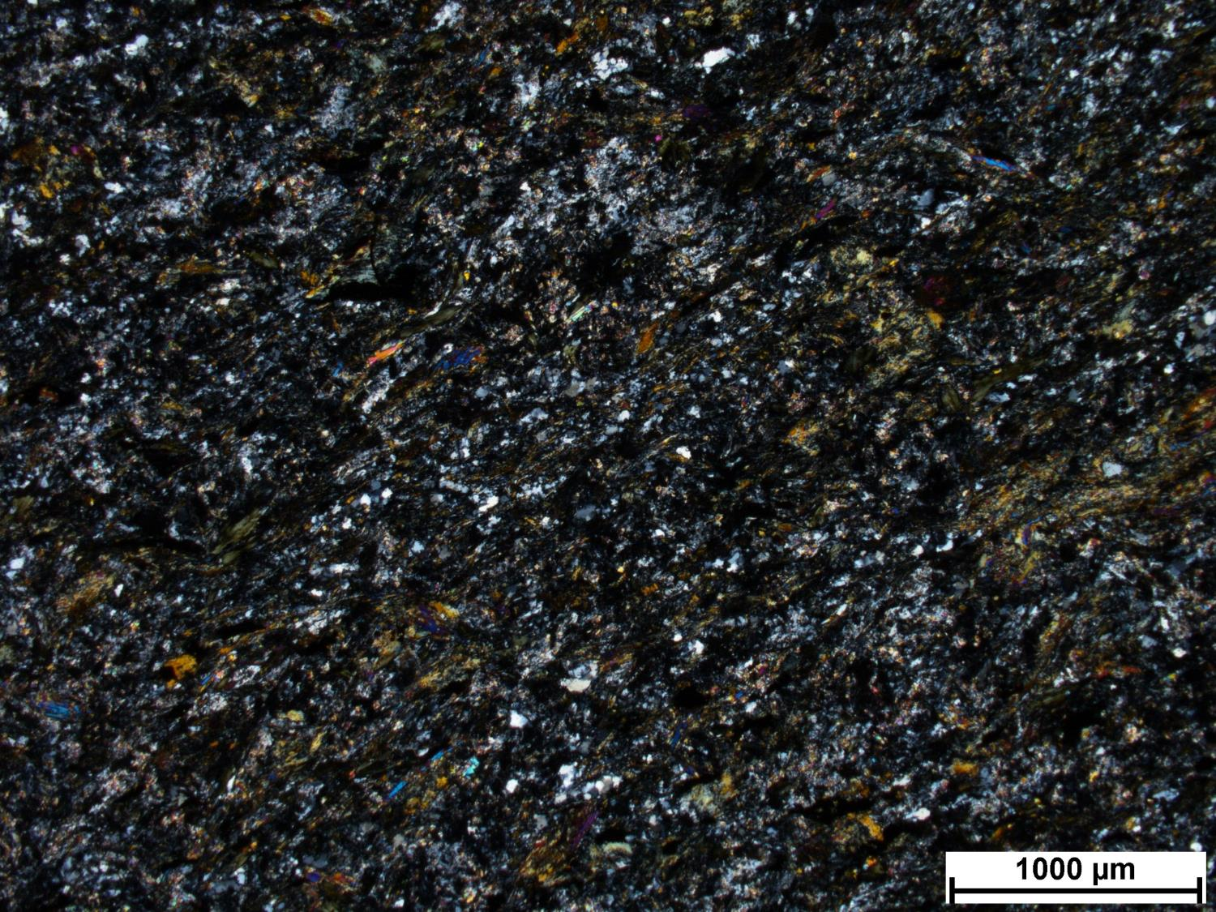
12A-3
Notes:
Protolith: volcanic or mafic dyke. Hard to tell if intrusive or extrusive because of deformation, maybe mafic dyke that cooled quickly
Very altered amphibole
Can be from CM region, or from Piche. Not from deposit.
Not far from source because soft.

Slide 4
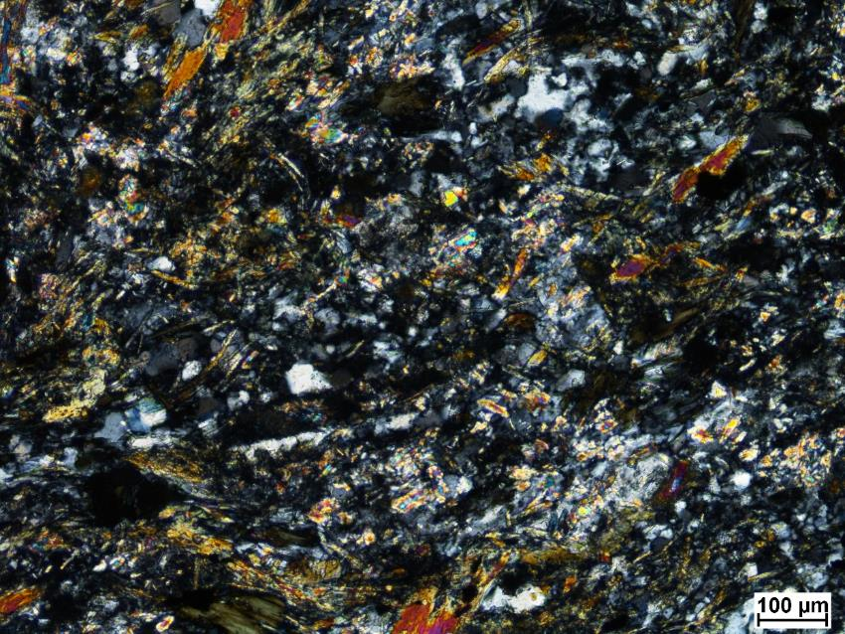
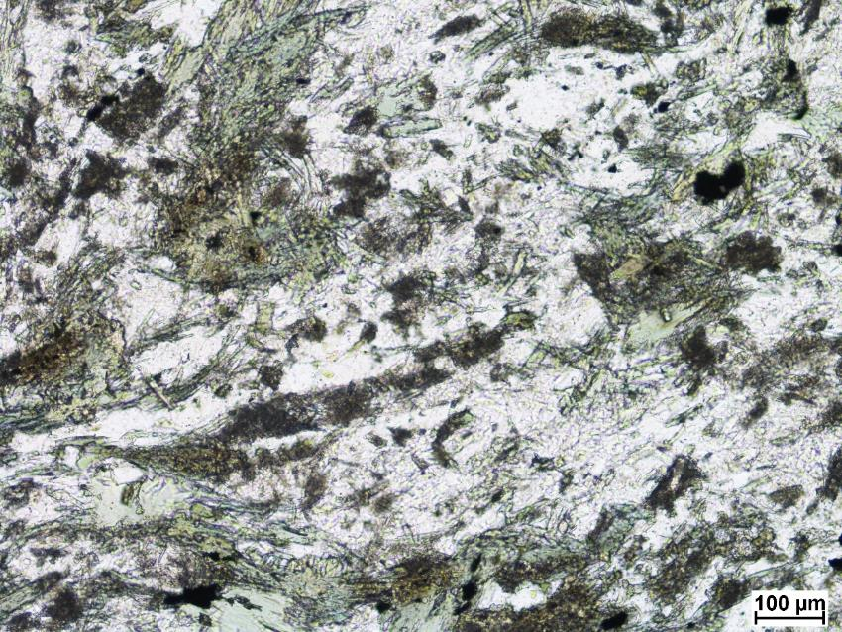

Slide 5
12A-5

Slide 6
SEM minerals
quartz, K-feldspar, muscovite, chlorite, titanite, epidote, zircon, iron oxide, rutile, allanite, pyrite

Slide 7
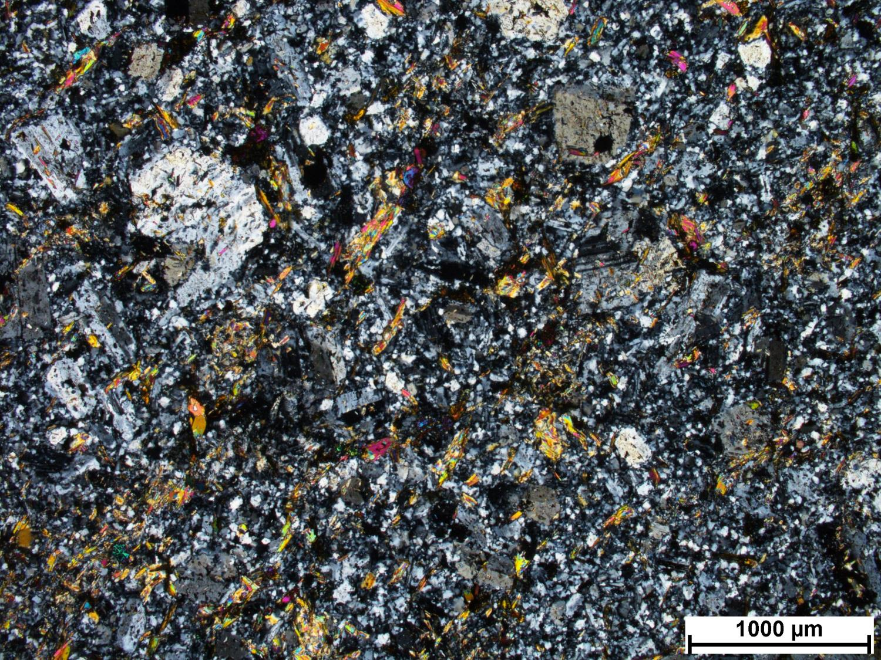
12A-5
Notes:
Similar to 12A-2. Porphyritic, more K-feldspar.
WM alteration, weathered (replaced biotite?)
Tabular plag, K-feldspar has monoclinic shape
More alkaline than CM, syenite-monzosyenite
Silicification, WM (weathered red, therefore maybe Bt replaced by muscovite)
Secondary rutile aggregates, associated with WM alteration (replacing Bt?)

Slide 8
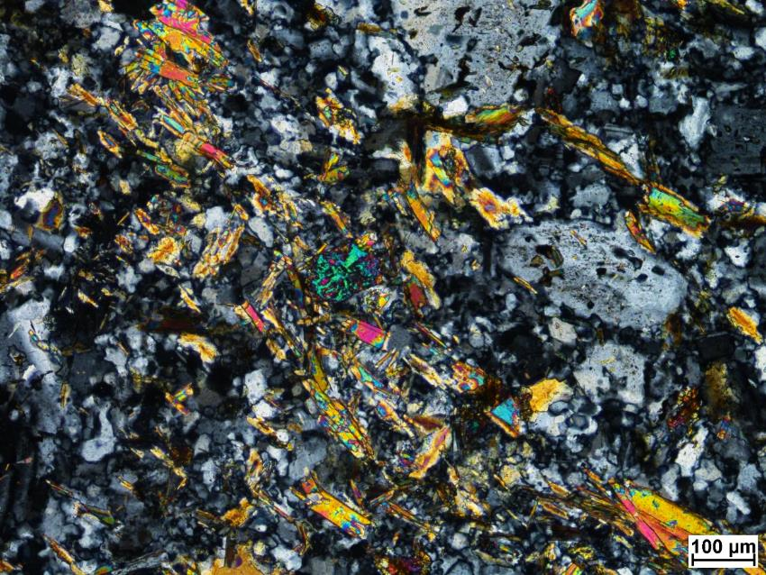
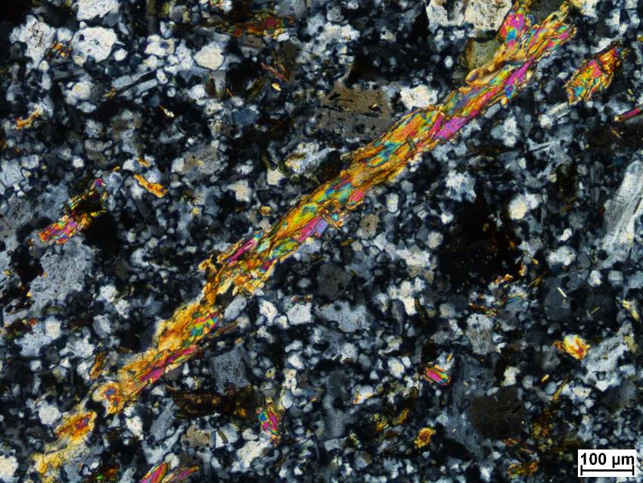

Slide 9
47A-1

Slide 10
SEM minerals
Plagioclase, K-feldspar, muscovite, chlorite, epidote, zircon, baddeleyite?

Slide 11
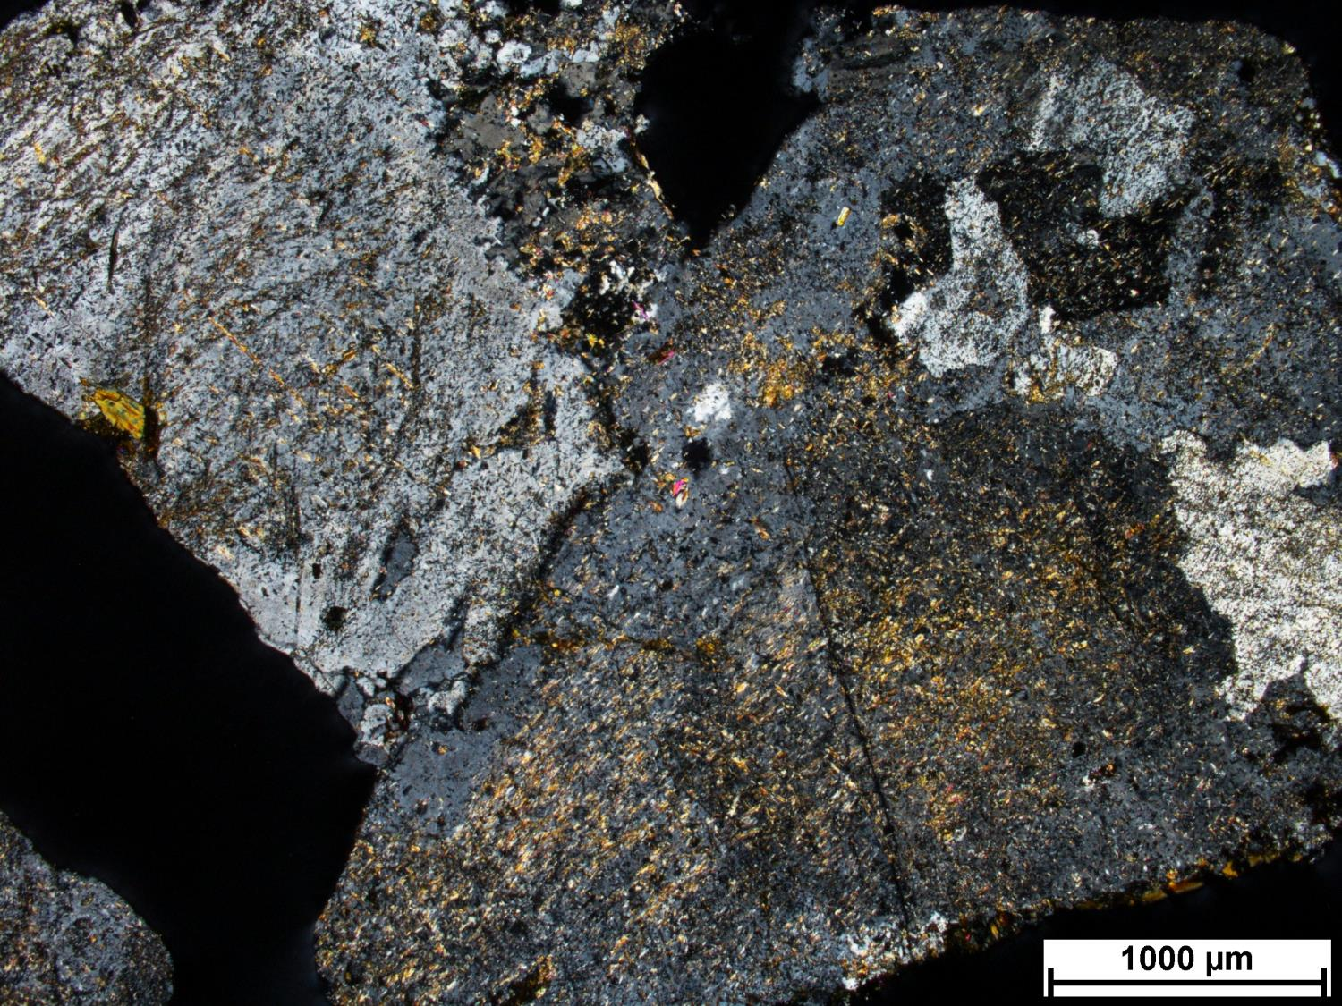
47A-1
Notes:

Slide 12
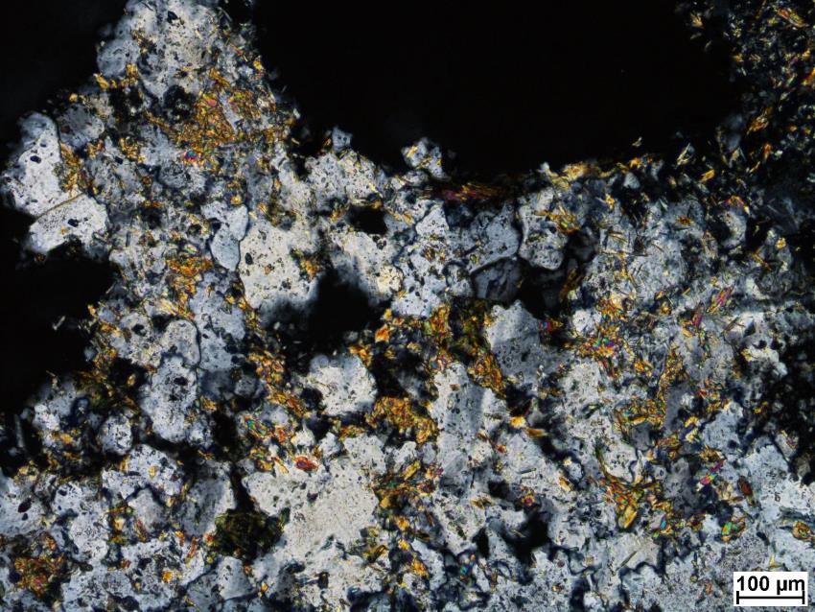
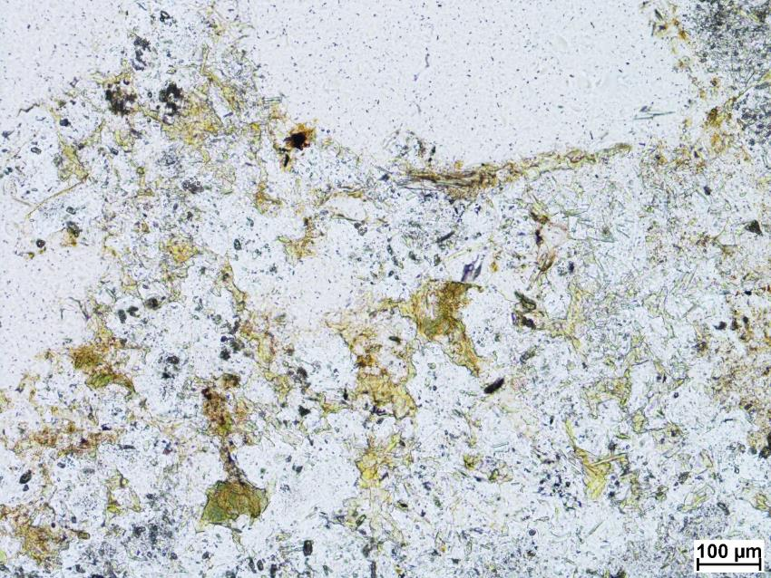

Slide 13
47A-2

Slide 14
SEM minerals
muscovite, chlorite, epidote, zircon, baddeleyite?, rutile

Slide 15
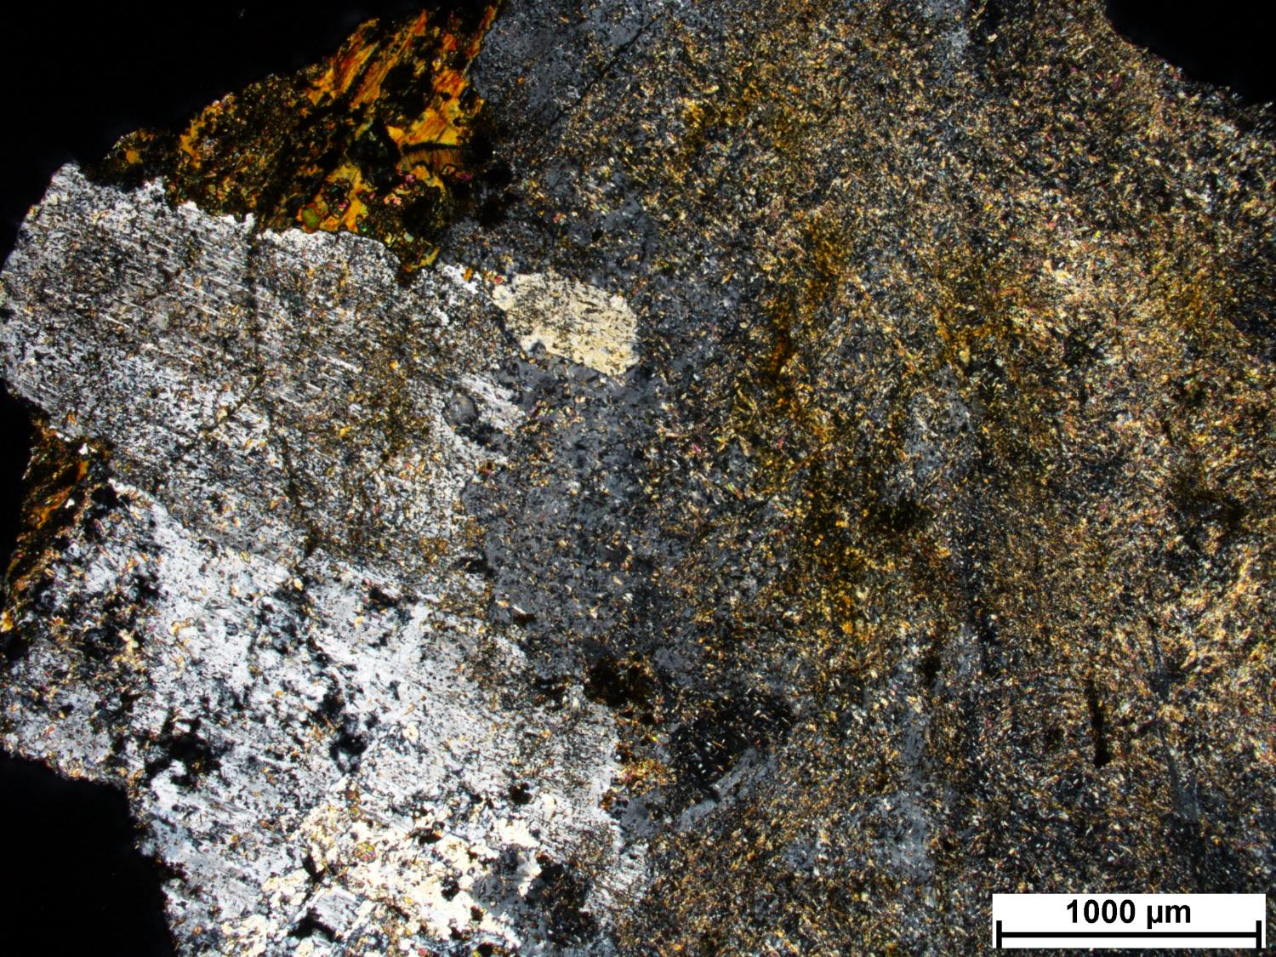
47A-2
Notes:

Slide 16
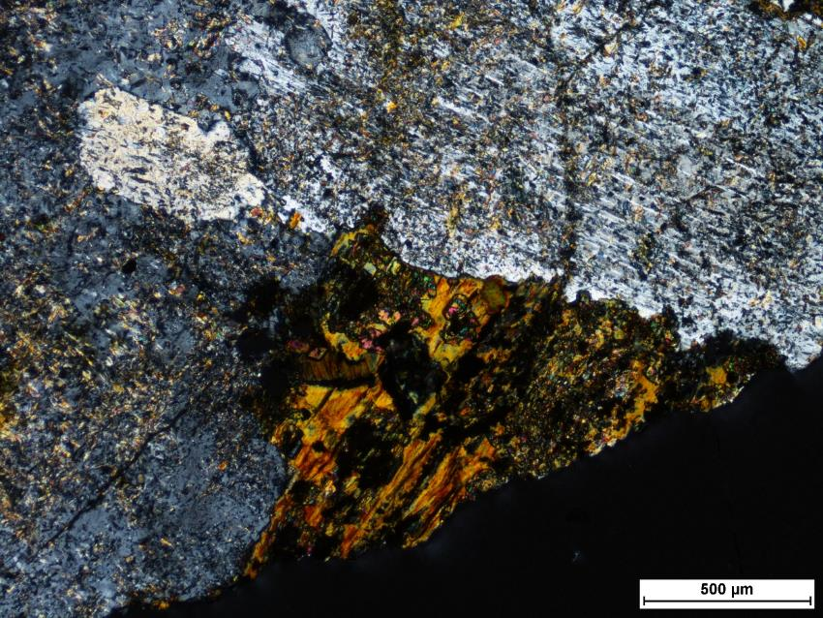
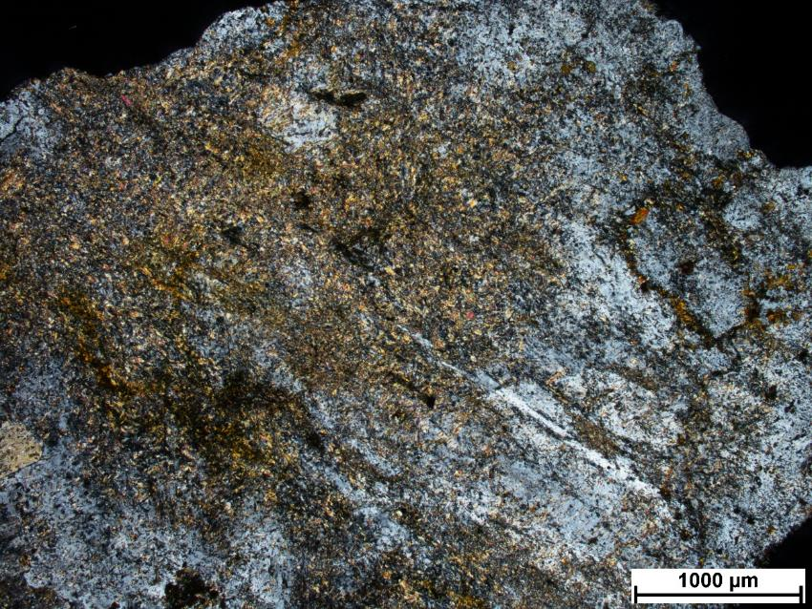

Slide 17
47A-3

Slide 18
SEM minerals
Allanite…

Slide 19
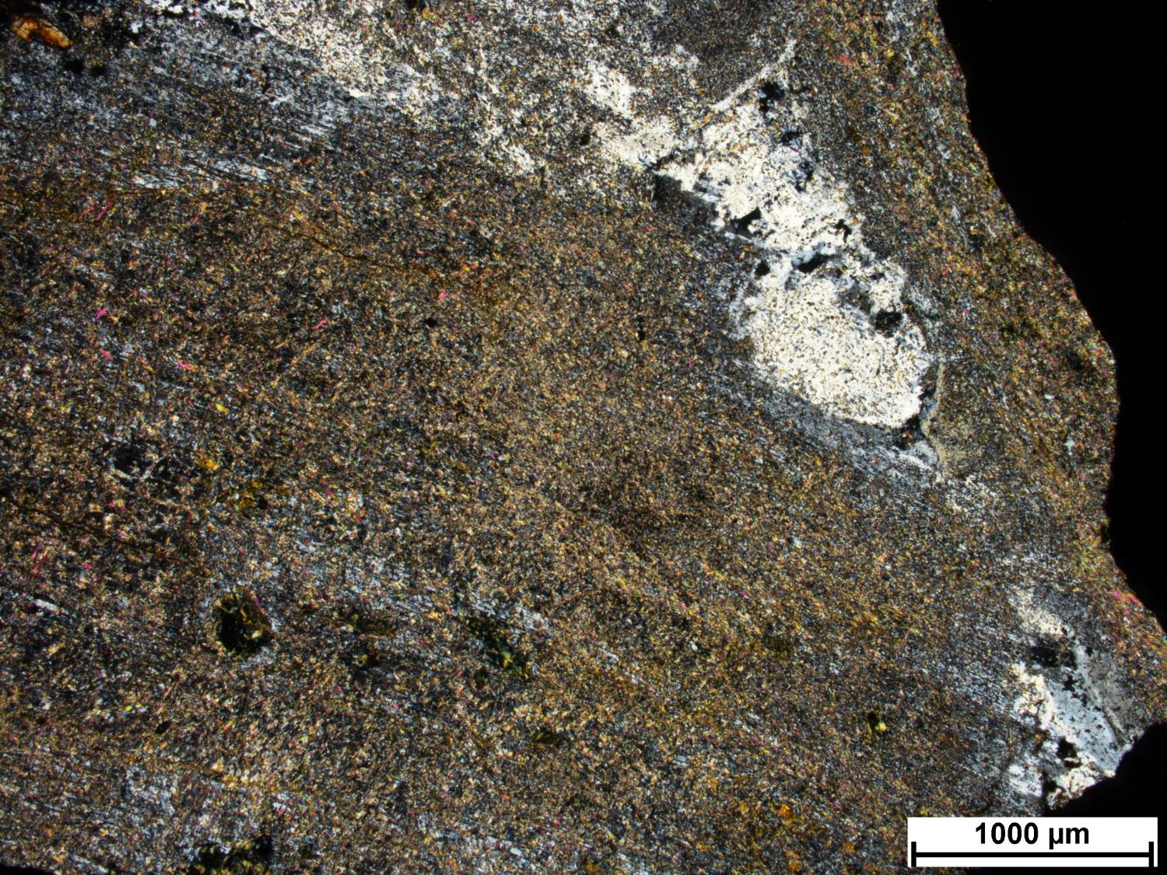
47A-3
Notes:

Slide 20
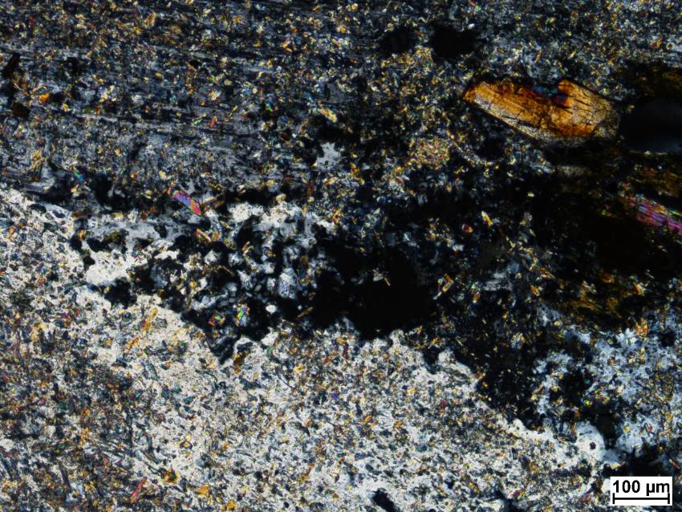
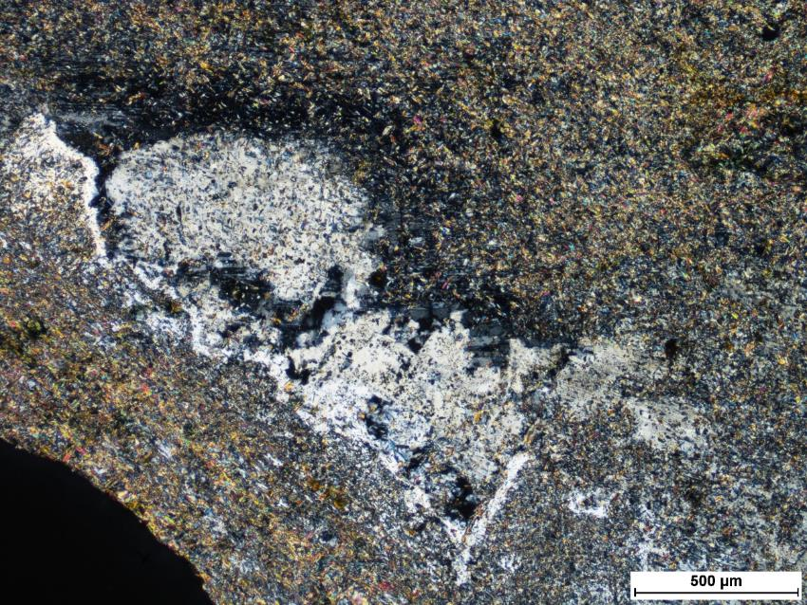

Slide 21
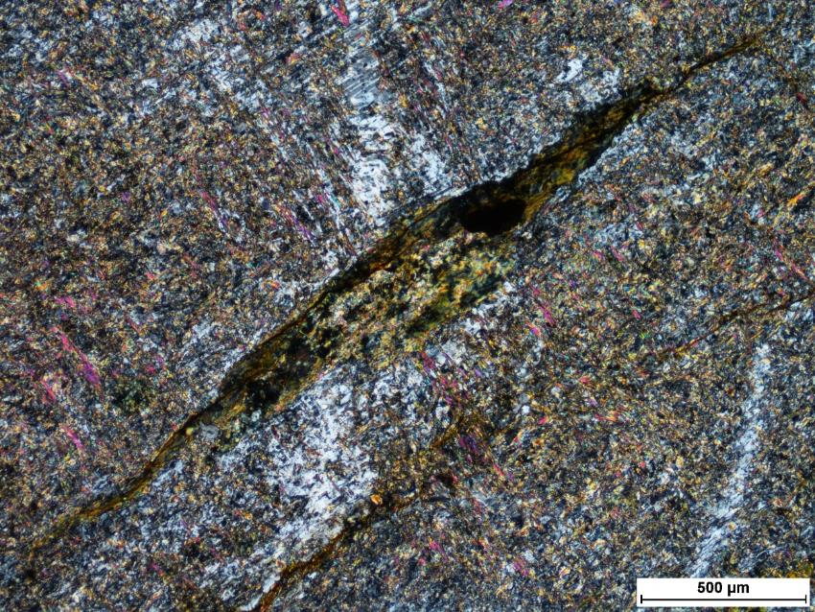
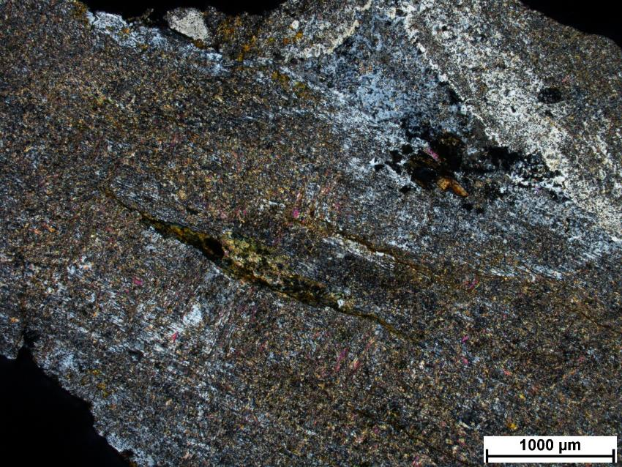

Slide 22
47A-4

Slide 23
SEM minerals
Plagioclase, quartz, muscovite, chlorite, epidote, zircon, iron oxide

Slide 24
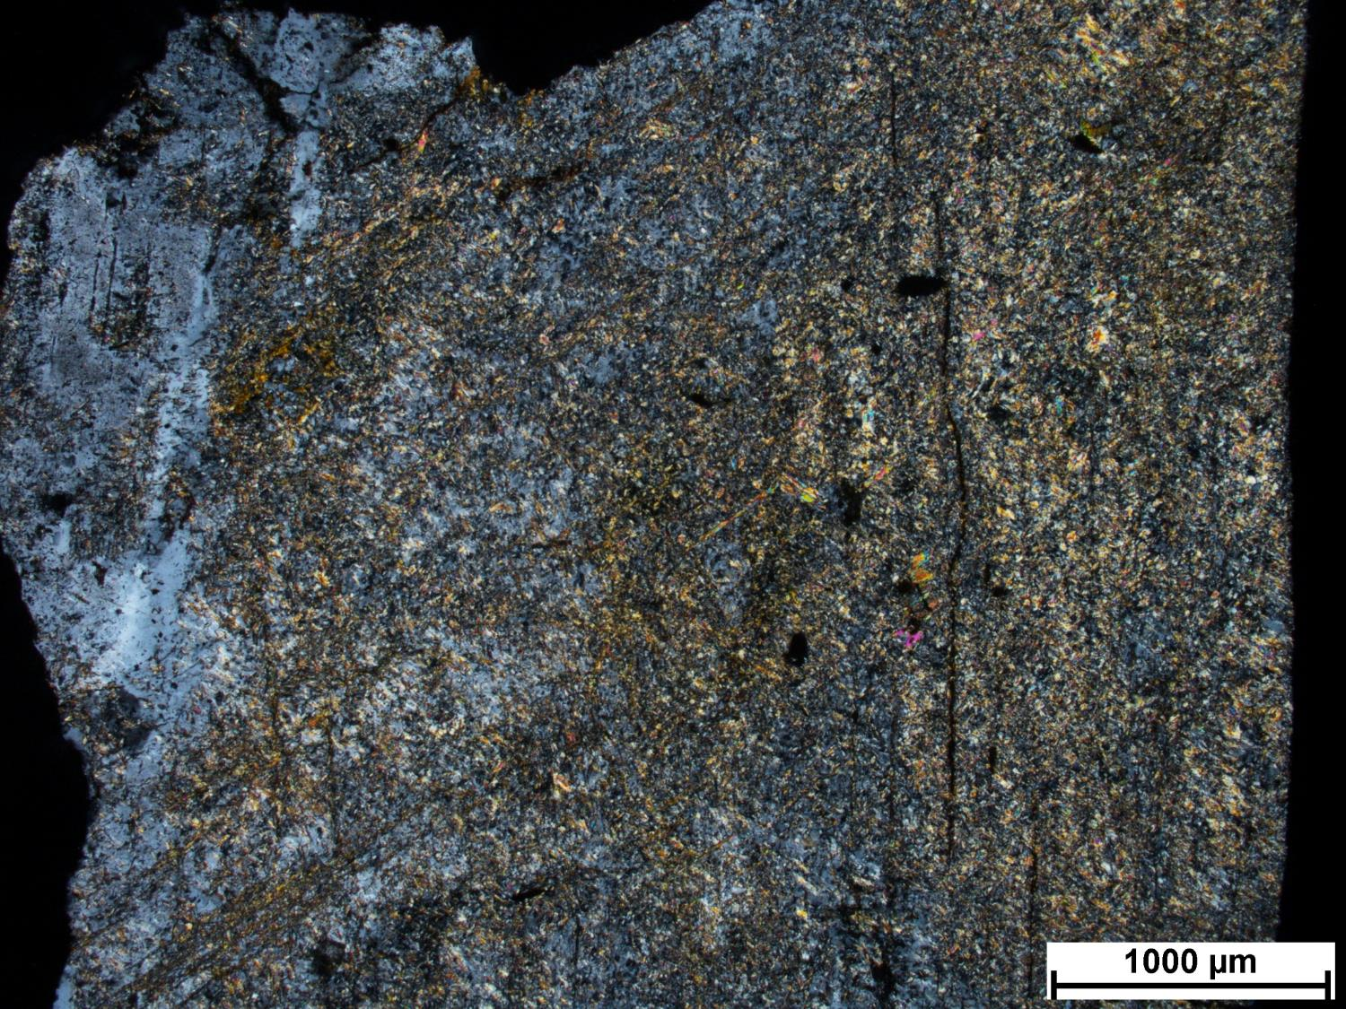
47A-4
Notes:

Slide 25
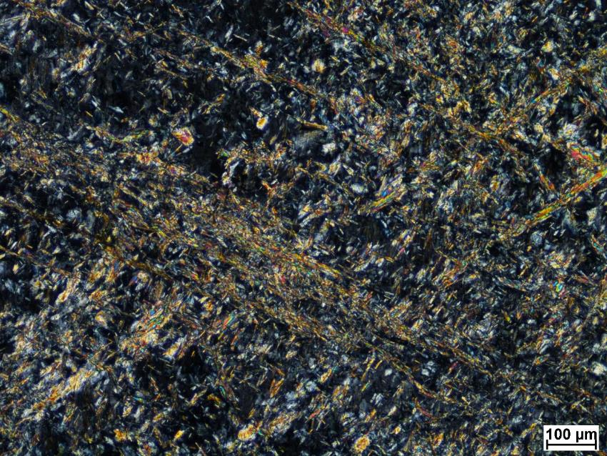
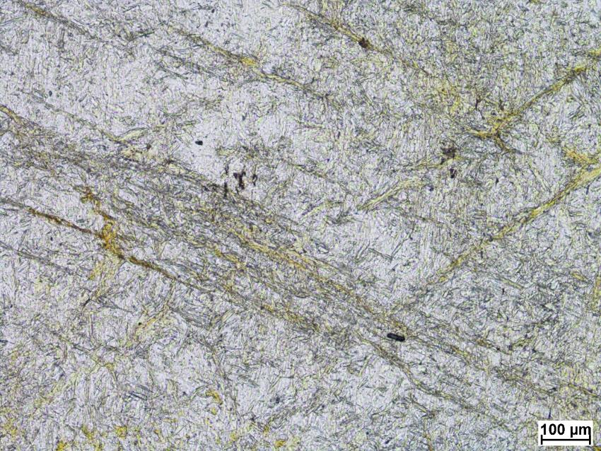

Slide 26
57A-1

Slide 27
SEM minerals
quartz, muscovite, chlorite, titanite, epidote, zircon, iron oxide, rutile

Slide 28
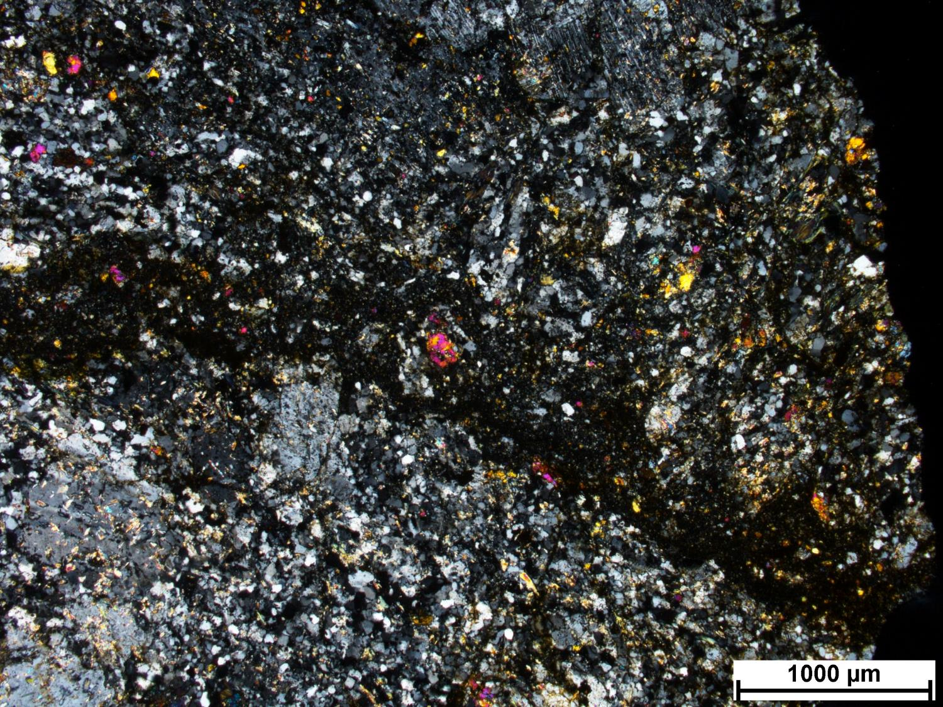
57A-1
Notes:
Intrusive, porphyritic rock, monazite, monzodiorite? Very deformed, hydrothermal alteration
Little rutiles, something mafic altered to rutile
More weathered than other rocks (Fe-hydroxides)
Zircon resistant to alteration, epidote less resistant
Too much chlorite to be representative of CM
Intense silicification, chlorite alteration
Plagioclase with corroded margins, WM alteration
Vein? Pathway for fluid, silica and chlorite alteration (Fe-rich chlorite) Brecciated zone, continuous. Zircons in zone. Late fluid percolation
Chlorite associated with zircons?

Slide 29
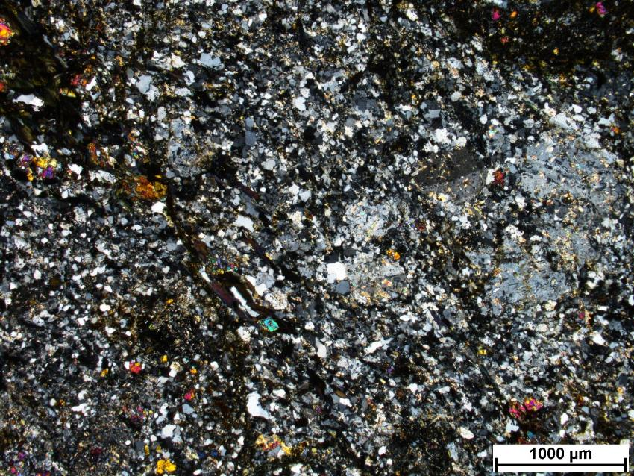
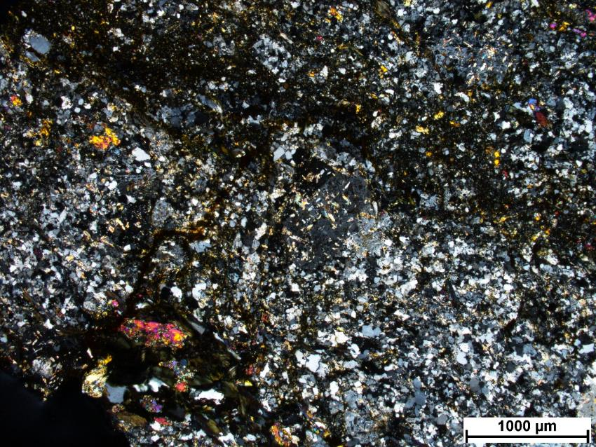

Slide 30
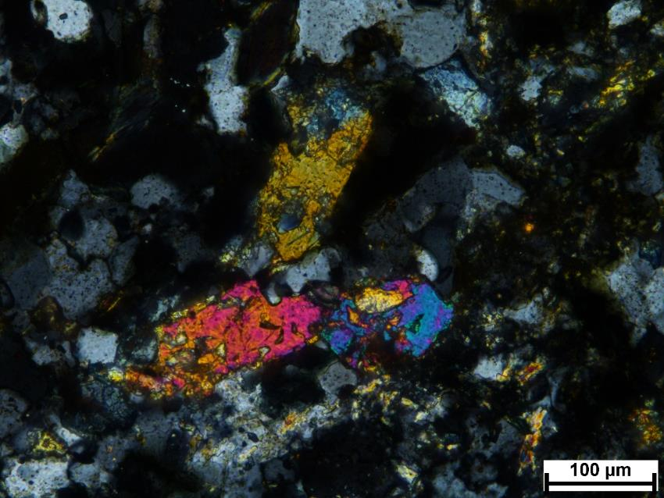
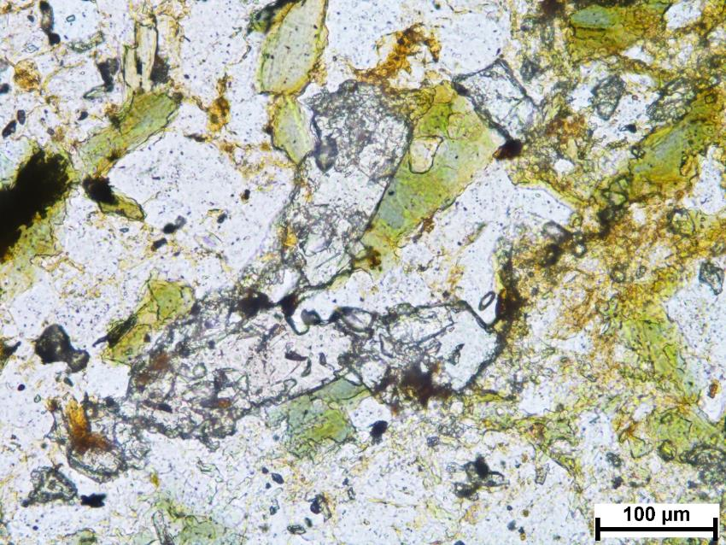

Slide 31
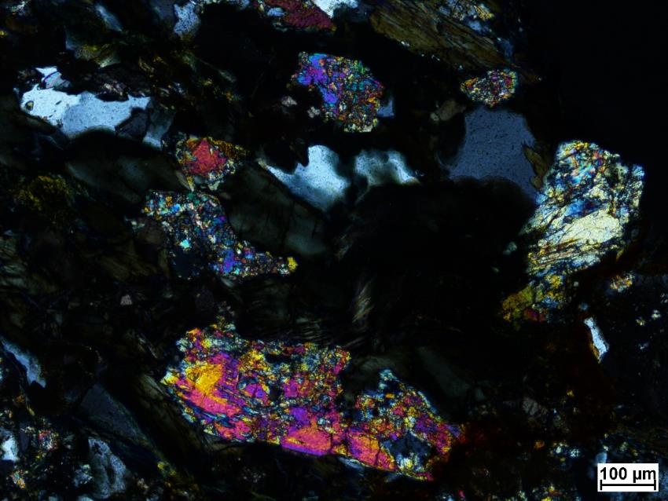
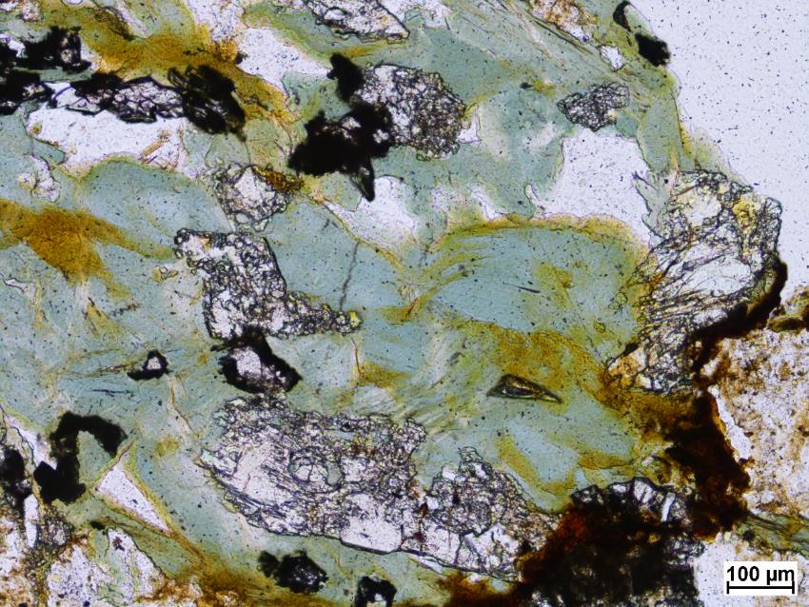

Slide 32
57A-3

Slide 33
SEM minerals
Plagioclase, quartz, K-feldspar, muscovite, biotite, chlorite, titanite, apatite, epidote, zircon, rutile, allanite

Slide 34
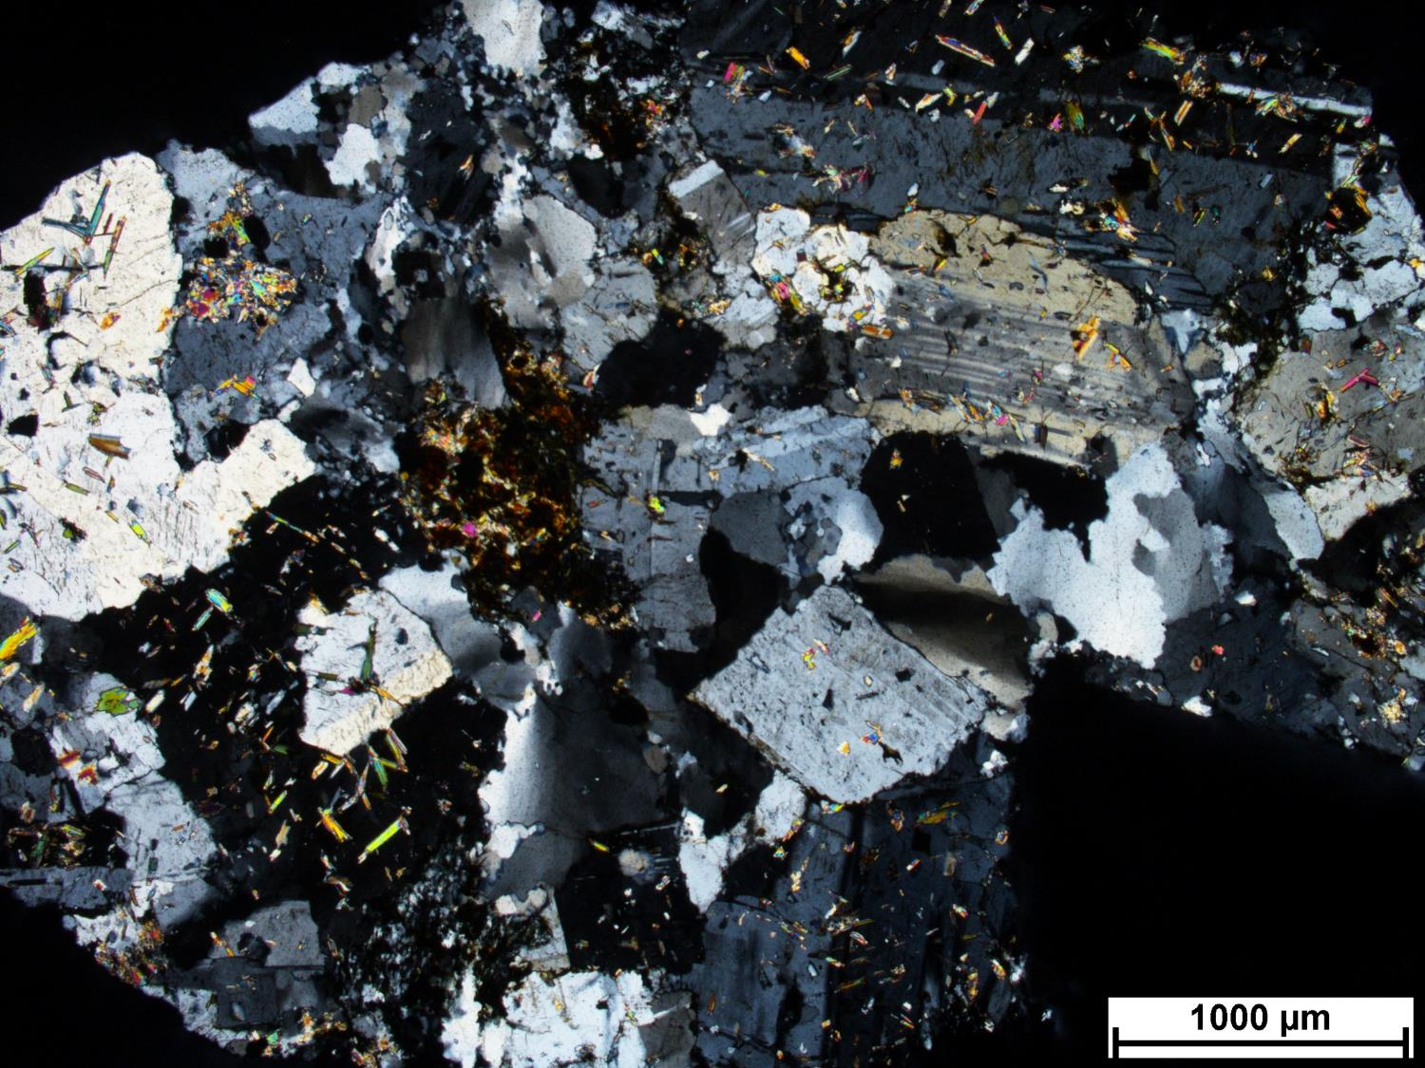
57A-3
Notes:
Intrusive, equigranular (crowed)
Zones with quartz, fragment of veinlet, zone of tension (sutures), vein cut perpendicular to thin section
Weathered
Plag alteration (silica?)
WM alteration on plag with corroded margins
Mystery photo apatite? Orange colour is weathering, maybe fr
WM on chlorite
Mafic minerals replaced by rutile and chlorite (with silicification?), then replaced by WM
Not similar to CM because thermal regime too low

Slide 35
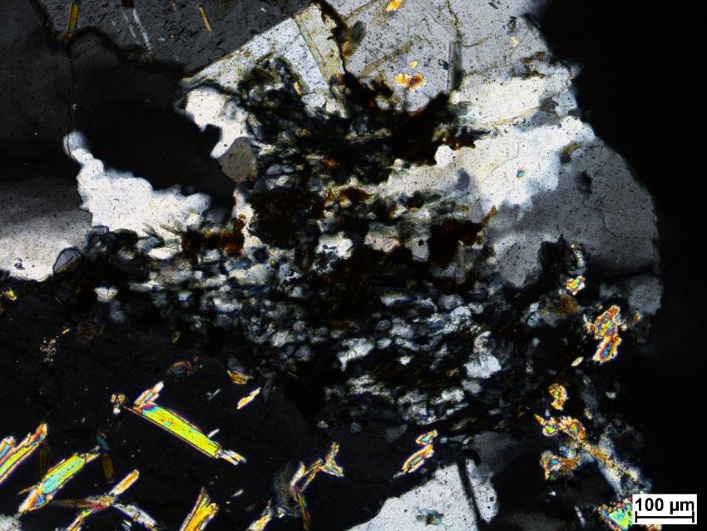
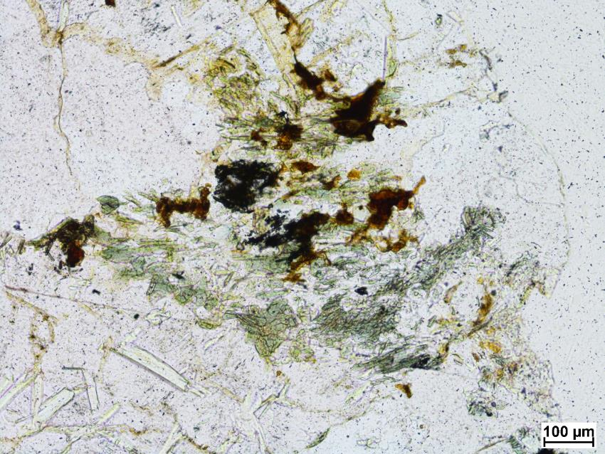

Slide 36
63A-3

Slide 37
SEM minerals
Plagioclase, quartz, K-feldspar, muscovite, chlorite, titanite, apatite, epidote, zircon, tourmaline, pyrite

Slide 38
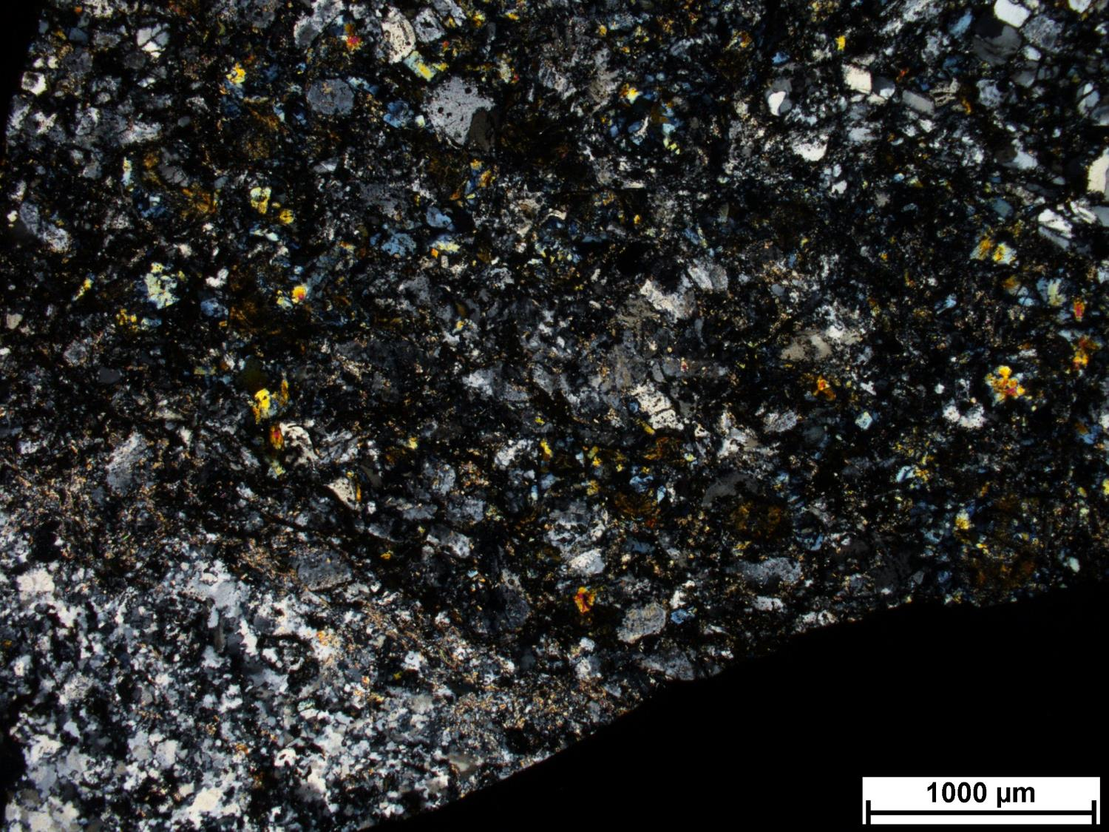
63A-3
Notes:
Zone with very intense silicification. Sutures, quite deformed. Deformed vein (host rock not as deformed).
Volcanic rock or amygdule that was filled
Quartz in “amygdule”

Slide 39
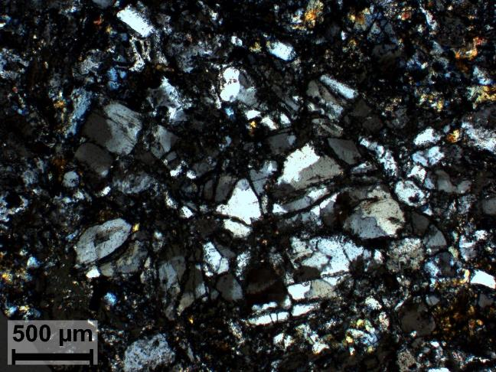
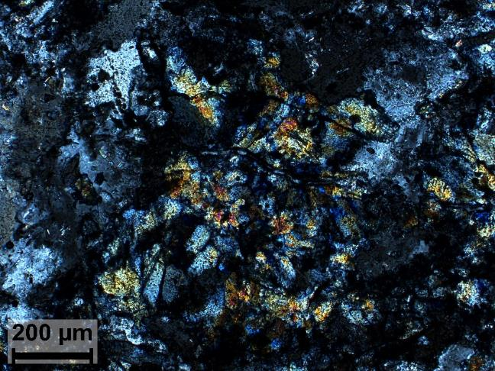

Slide 40
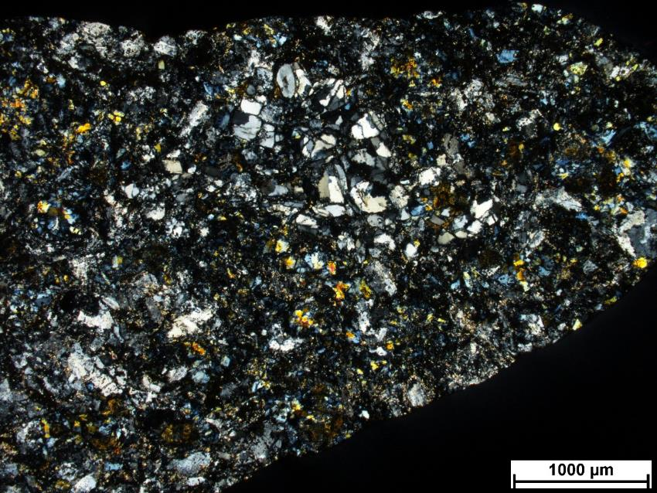
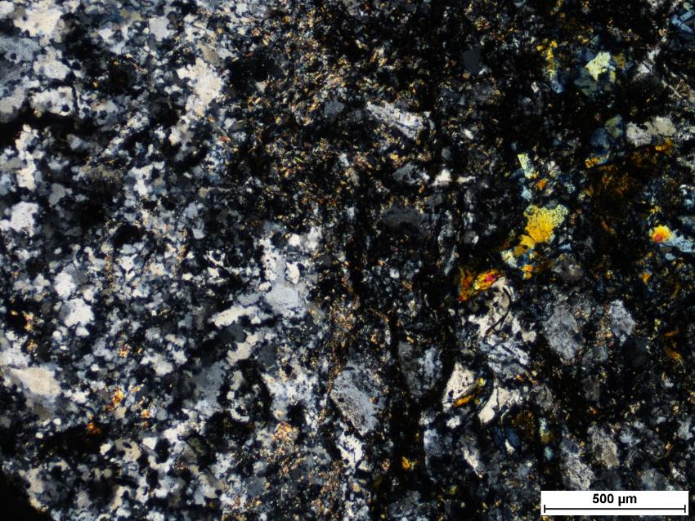

Slide 41
63A-4

Slide 42
SEM minerals
Plagioclase, K-feldspar, muscovite, biotite, chlorite, titanite, apatite, zircon, iron oxide, Th-phosphate, tourmaline, rutile, allanite, silver, molybdenite

Slide 43
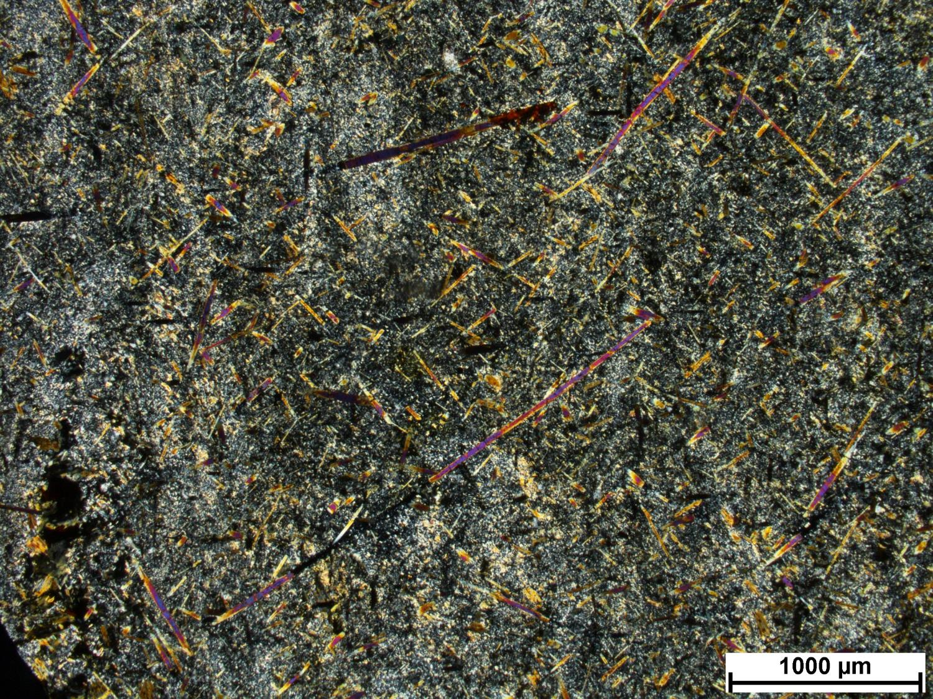
63A-4
Notes:
Acicular tourmaline, biotite as well
Completely altered, cannot discern the protolith
Fine sericite. Mafics altered to biotite. Chlorite as well.
Chl
-Pl-Kfs-Ms
-Tur
-Hem
-Bt
-Bt

Slide 44
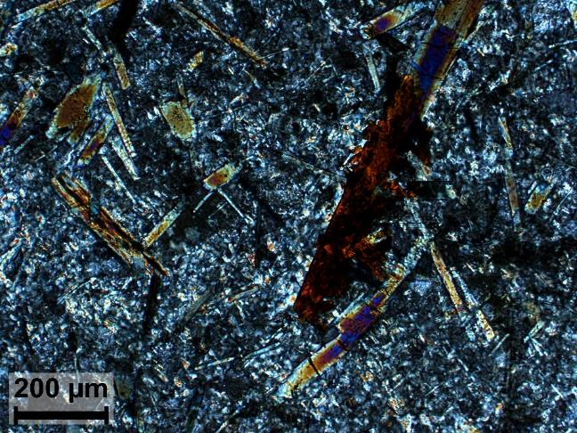
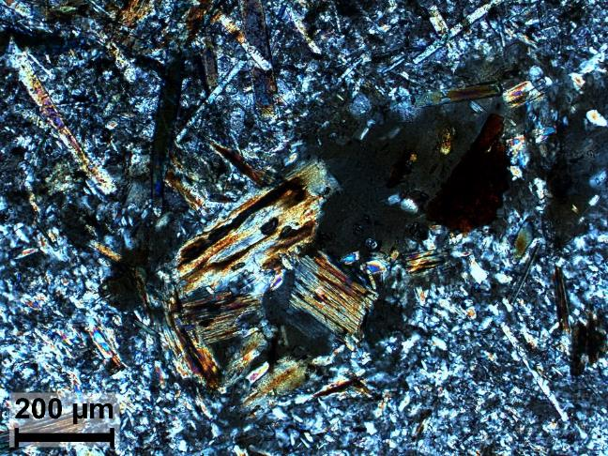

Slide 45
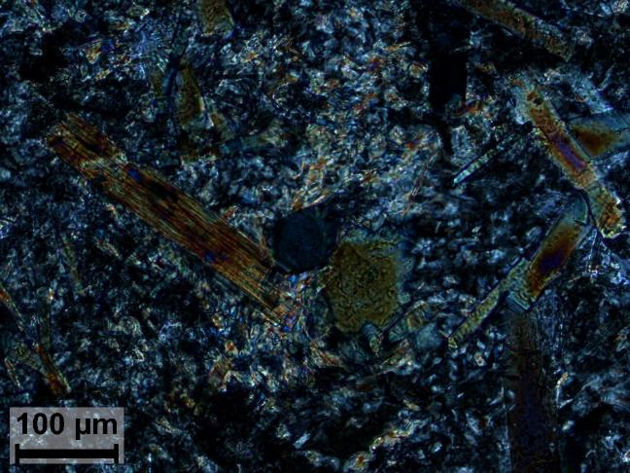

Slide 46
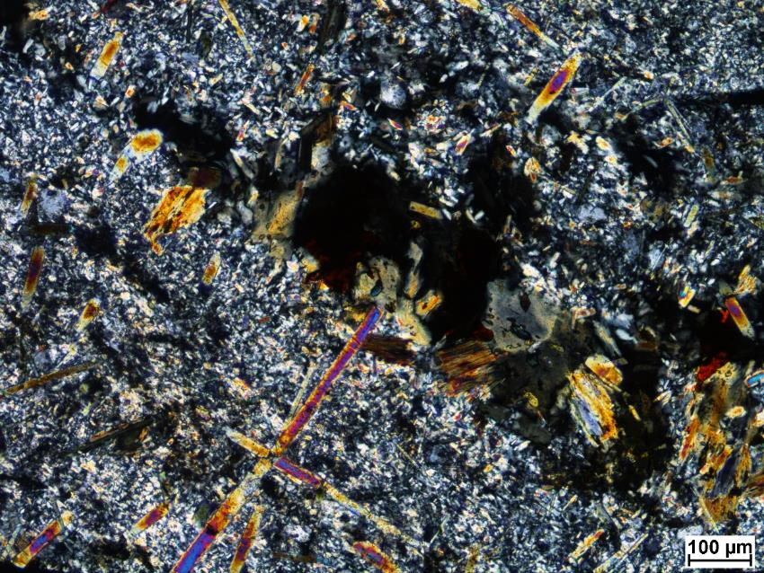
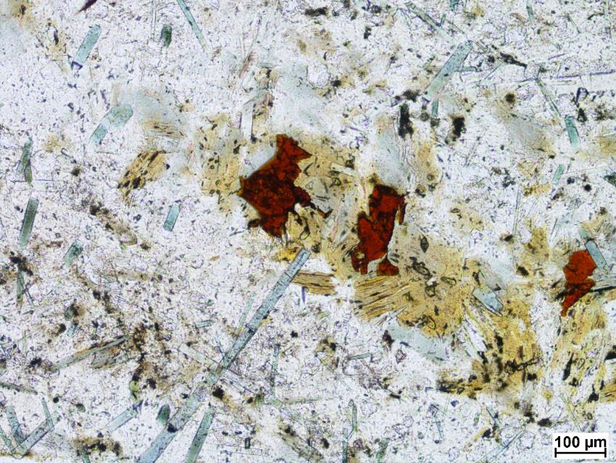

Slide 47
SS1-3

Slide 48
SEM minerals
Plagioclase, quartz, muscovite, biotite, chlorite, titanite, apatite, zircon, iron oxide, Y-phosphate, U-thorite, rutile

Slide 49
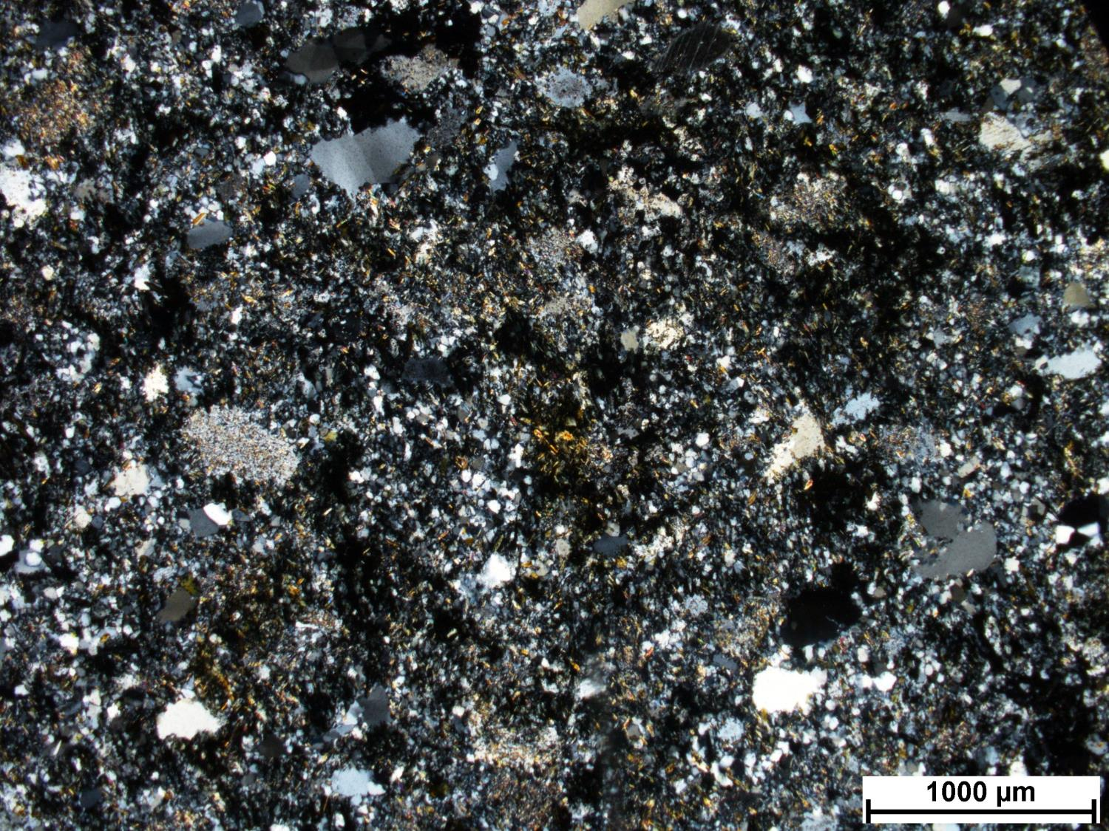
SS1-3
Notes:
Primary plagioclase heavily altered, replaced by white mica. Corroded margins.
Remnant fine-grained biotite (metamorphic?), corroded thin laths, being replaced by chlorite.
Red rutile. Apatite.
Chlorite alteration.
Lower temperature alteration. Extensively altered, primary texture is not preserved.
Opaques associated with alteration minerals.
Very altered greywacke? Lower metamorphic grade than in Pontiac, so maybe Abitibi. Maybe volcanic. Greenschist phase. Chlorite, very stable, dominant alteration mineral, replacing bt.
White mica replacing feldspars.
Feldpsar, then white mica, then chlorite and associated opaques.

Slide 50
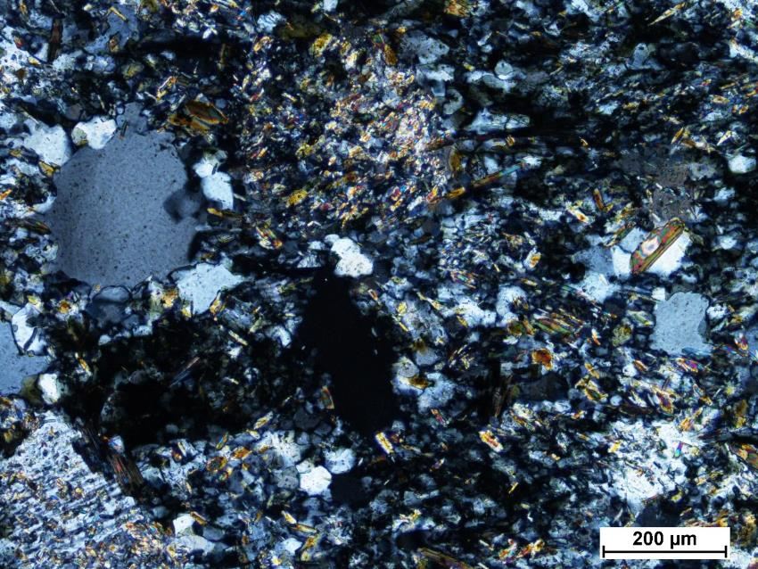
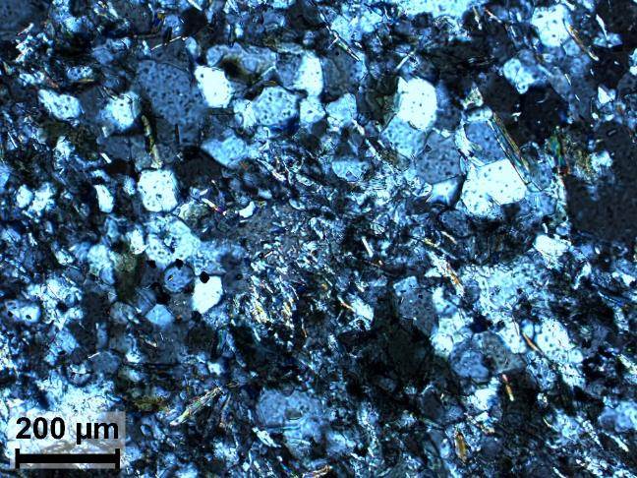

Slide 51
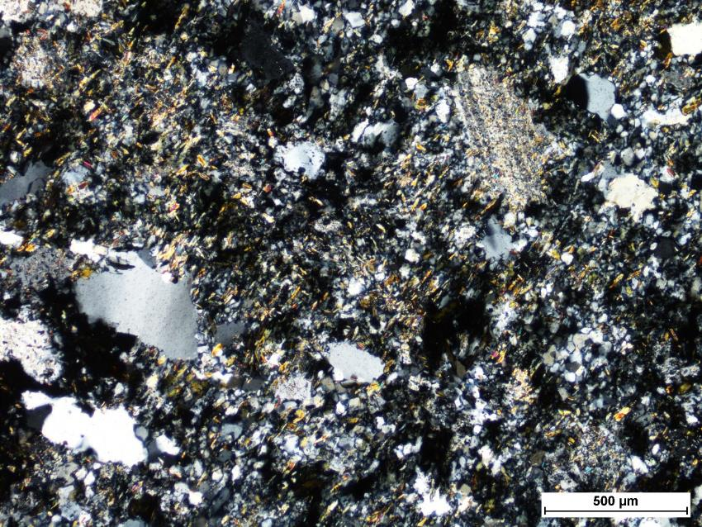
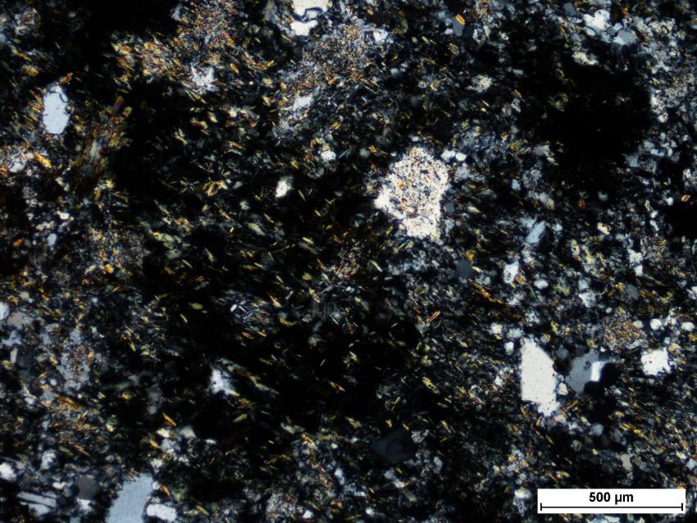

Slide 52
SS1-4

Slide 53
SEM minerals
Plagioclase, K-feldspar, muscovite, chlorite, zircon, monazite, thorite, rutile, allanite

Slide 54
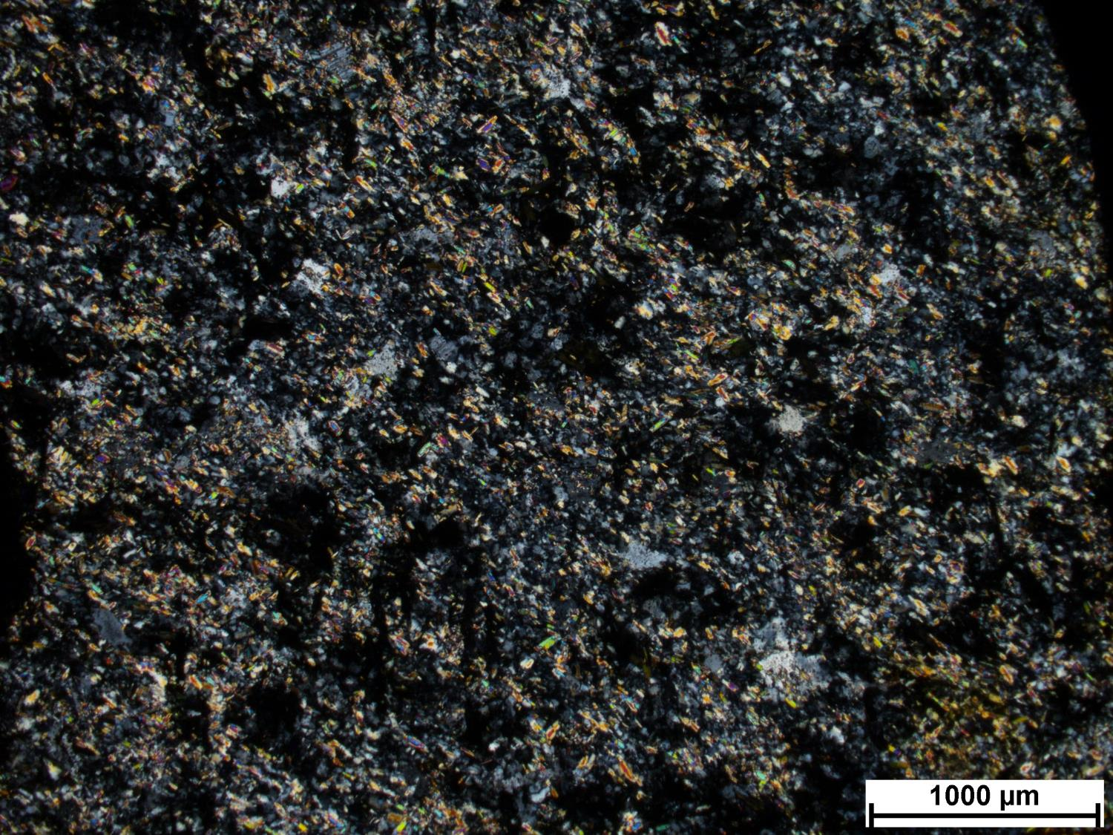
SS1-4
Notes:
Similar to SS1-3
More intensive sericite, white mica alteration.
Lots of chlorite with opaques.
Primary texture not preserved so cannot tell if sedimentary or intrusive.
From the Abitibi? Because lower metamorphic grade (or possibly close to a fault, getting washed by lots of colder fluids). Pontiac metased have more Bt because higher temperature metamorphism.

Slide 55
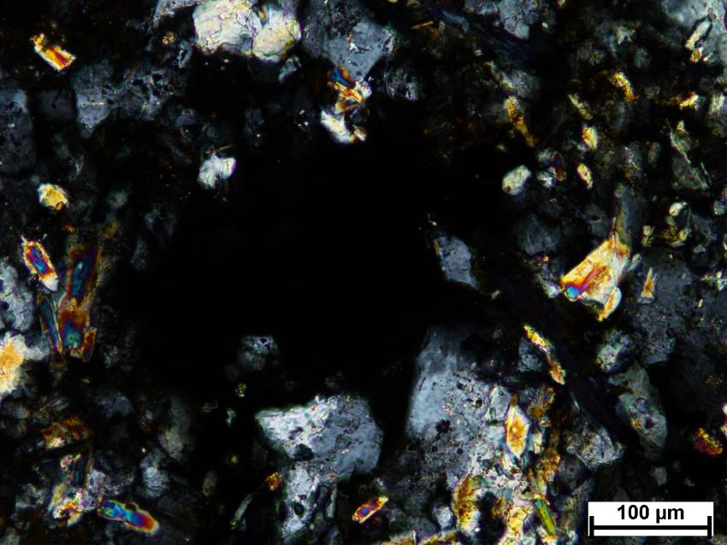
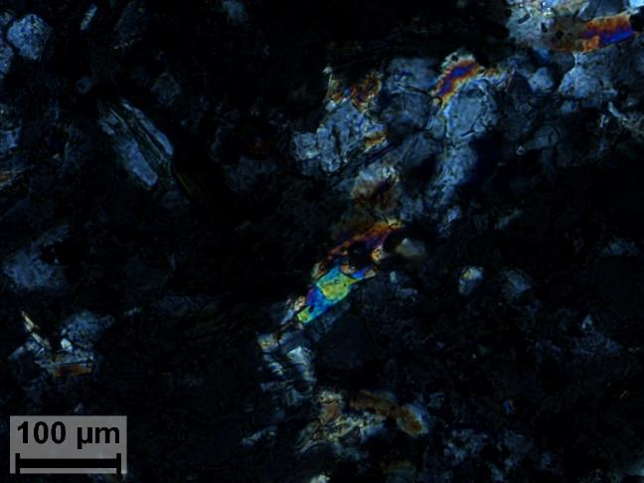

Slide 56
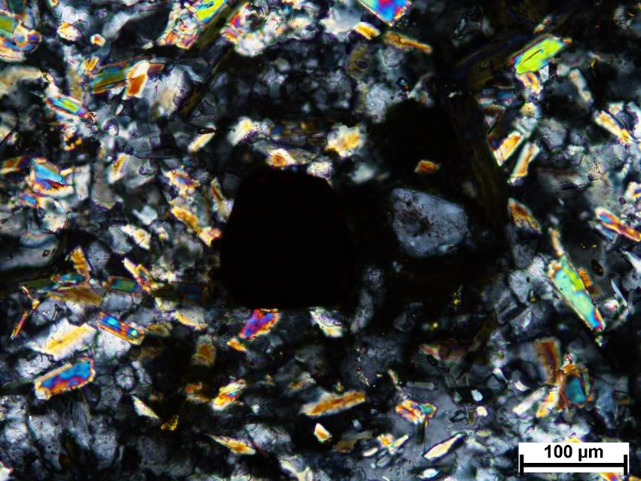


Slide 57
SS3-6

Slide 58
SEM minerals
Plagioclase, quartz, muscovite, biotite, chlorite, titanite, apatite, epidote, zircon, iron oxide, monazite, chalcopyrite, rutile, pyrite, silver

Slide 59

SS3-6
Notes:
Deformed
Pressure shadows around Py, syn-kinematic with foliation. Chlorite in pressure shadow sometimes
Altered greywacke
Chlorite replacing Bt. Remnant Bt in chlorite.
Ask Carl and Nic if they have seen this much chlorite
WM alteration
Remnant stauralite? Altered
Py associated with chlorite, Bt aggregates

Slide 60



Slide 61



Slide 62
Rutile replacement
Silver

Slide 63
Texture

Slide 64
SS3-bottomright

Slide 65
SEM minerals
Plagioclase, quartz, K-feldspar, muscovite, biotite, chlorite, titanite, apatite, epidote, zircon, iron oxide, barite, allanite

Slide 66

SS3-bottomright
Notes:
Magmatic Bt replaced by chlorite
Volcanic or very shallow intrusive
Fine-grained altered crystals (so not metased)
Feldspar-rich
Maybe Abitibi (WM compatible, retrograde chlorite)

Slide 67



Slide 68



Slide 69
Allanite

Slide 70
SS7-1

Slide 71
SEM minerals
quartz, K-feldspar, muscovite, titanite, apatite, epidote, zircon, ilmenite, rutile

Slide 72

SS7-1
Notes:

Slide 73



Slide 74



Slide 75
SS7-2

Slide 76
SEM minerals
quartz, K-feldspar, muscovite, biotite, titanite, zircon, monazite, Y-phosphate

Slide 77

SS7-2
Notes:

Slide 78



Slide 79



Slide 80
SS7-3

Slide 81
SEM minerals
Plagioclase, quartz, K-feldspar, muscovite, chlorite, zircon, iron oxide, monazite, Y-phosphate, rutile, allanite, pyrite

Slide 82

SS7-3
Notes:

Slide 83



Slide 84
SS7-4

Slide 85
SEM minerals
Plagioclase, quartz, K-feldspar, muscovite, biotite, chlorite, titanite, apatite, epidote, zircon, iron oxide, monazite, rutile

Slide 86

SS7-4
Notes:

Slide 87



Slide 88
SS7-5

Slide 89
SEM minerals
Plagioclase, quartz, K-feldspar, muscovite, biotite, chlorite, titanite, apatite, epidote, zircon, monazite, barite, rutile, allanite, pyrite

Slide 90

SS7-5
Notes:

Slide 91



Slide 92
SS7-6

Slide 93
SEM minerals
Plagioclase, quartz, muscovite, biotite, apatite, epidote, zircon, iron oxide

Slide 94

SS7-6
Notes:

Slide 95



Slide 96
Allanite

Slide 97
SS9-2

Slide 98
SEM minerals
Plagioclase, quartz, K-feldspar, muscovite, titanite, apatite, epidote, zircon, rutile, pyrite

Slide 99

SS9-2
Notes:
Silicification, WM alteration
Groundmass, altered porphyroclasts?
Lots of rutile, epidote
K-feldspar and plag in groundmass. More towards a syenite because more K-spar.
Monoclinic shape for

Slide 100



Slide 101
SS9-3

Slide 102
SEM minerals
Plagioclase, quartz, K-feldspar, muscovite, chlorite, titanite, apatite, zircon, rutile, allanite

Slide 103

SS9-3
Notes:
Crowded igneous feldspars. No groundmass. Equigranular, not porphyritic.
Rutile associated with Bt (replaced by chlorite), so if W-rich then from another deposit. Mainly large rutile with chlorite. WM seems to be replacing chlorite. WM alteration
Microcline, plagioclase
Fe-rich chlorite alteration. Also rutile, maybe replacing Bt.
If from Pontiac, chlorite alteration occurred before metamorphism. Does not seem to be from Pontiac because too much chlorite.
Chlorite replaces magmatic Bt.

Slide 104



Slide 105
W-enriched rutile

Slide 106
SS9-5

Slide 107
SEM minerals
Plagioclase, quartz, K-feldspar, biotite, chlorite, titanite, epidote, zircon, rutile, allanite

Slide 108

SS9-5
Notes:
More K-spar than plag, so different source than those with lots of plag
Crowded.
Monzonite, syenite
Some silicification, WM mainly
Magmatic Bt replaced by WM
Lots of little rutile where Bt altered.

Slide 109



Slide 110
SS19-2

Slide 111
SEM minerals
quartz, K-feldspar, muscovite, biotite, chlorite, apatite, zircon, ilmenite, monazite, thorite, rutile, pyrite

Slide 112

SS19-2
Notes:
Intrusive rock. Main alteration big white micas? Tremolite? Actinolite? Sometimes radial. (Ti-muscovite?, saved spectrum)
Heavy alteration. Hydrothermal alteration.
Altered quartz clasts? Qtz aggregates.
White mica? Replacing other phase of “clasts” (as opposed to qtz aggregates)
Not similar to CM. White mica texture different.
Polymict conglomerate.

Slide 113



Slide 114



Slide 115
Mo in pyrite
Monazite

Slide 116
SS19-3

Slide 117
SEM minerals
Plagioclase, quartz, muscovite, chlorite, titanite, apatite, iron oxide, monazite, scheelite, pyrite

Slide 118

SS19-3
Notes:
Very altered, can recognize remnant shapes of grains (plagioclase?)
Brecciated intrusive rock?
Completely altered to muscovite? Check for carbonate in alteration. Sericite alteration, and maybe quartz or albite. Cement (hydrothermal) of breccia.
Chlorite.
Lower temperature minerals than in Pontiac. Too much chlorite to be typical of CM.

Slide 119



Slide 120



Slide 121
SS19-4

Slide 122
SEM minerals
quartz, muscovite, titanite, apatite, zircon, iron oxide, monazite

Slide 123

SS19-4
Notes:
Meta-sed or meta-epiclastic.
Foliation.
Not intrusive. Siltstone?
Lots of chlorite, sericite, typical of greenschist metamorphism.
Possibly mafic phase replace by rutile and chlorite.
More similar to Abitibi than Pontiac.
-Ms-Bt
IO
-Qtz-Pl-Kfs

Slide 124



Slide 125



Slide 126
SS19-5

Slide 127
SEM minerals
Plagioclase, quartz, muscovite, amphibole, chlorite, titanite, epidote, iron oxide, sphalerite, barite

Slide 128

SS19-5
Notes:
From Jim: replaced “phenocrysts” generally quartz margins and chlorite cores

Slide 129



Slide 130



Slide 131
SS49-3

Slide 132
SEM minerals
Plagioclase, quartz, muscovite, chlorite, titanite, apatite, zircon, iron oxide, ilmenite, rutile

Slide 133

SS49-3
Notes:

Slide 134



